Slide 1
Tic-Tac-Toe Game (Using Python)
Presented by:
Shatakshi Dudala

Slide 2
Introduction to Tic Tac Toe
Tic Tac Toe, also known as Noughts and Crosses, is a simple yet strategic two-player game played on a 3x3 grid.
Players take turns marking a space with their symbol—either X or O.
The objective is to be the first to align three of their symbols horizontally, vertically, or diagonally.
Despite its simplicity, Tic Tac Toe helps develop critical thinking, logic, and strategy.
It is often used as an introductory project in programming because of its straightforward rules and ease of implementation, making it a great way to learn game loops, conditions, and user interaction in Python or other languages.

Slide 3
Objectives
Create an interactive console-based Tic Tac Toe game.
Use Python with a clean and modular code structure.
Include a user-friendly interface.
Implement efficient win-checking logic.

Slide 4
Game Flow Overview
Display empty board.
Players alternate turns.
Input validation for correct and unoccupied positions.
Check for win or draw after each turn.
Display result and option to restart.

Slide 5
Unique Features
Optimized board rendering.
Efficient win-checking using sets.
Modular code: clear separation of logic and UI.
Support for replays.

Slide 6
Python COde
import tkinter as tk
from tkinter import messagebox
def check_winner():
for combo in [[0,1,2],[3,4,5],[6,7,8],[0,3,6],[1,4,7],[2,5,8],[0,4,8],[2,4,6]]:
if buttons[combo[0]]["text"] == buttons[combo[1]]["text"] == buttons[combo[2]]["text"] !="":
buttons[combo[0]].config(bg="green")
buttons[combo[1]].config(bg="green")
buttons[combo[2]].config(bg="green")
messagebox.showinfo("Tic-Tac-Toe", f"Player {buttons[combo[0]]['text']} wins!")
root.quit()

Slide 7
def button_click(index):
if buttons[index]["text"] == "" and not winner:
buttons[index]["text"] = current_player
check_winner()
toggle_player() def toggle_player():
global current_player
current_player = "X" if current_player == "O" else "O"
label.config(text=f"Player {current_player} 's turn")
root = tk.Tk()
root.title("Tic-Tac-Toe")
buttons = [tk.Button(root, text="", font=("normal", 25), width=6, height=2, command=lambda i=i: button_click(i)) for i in range(9)]

Slide 8
for i, button in enumerate(buttons):
button.grid(row=i //3, column=i %3)
current_player = "X"
winner = False
label = tk.label(root, text=f"Player {current_player}'s turn", font=("normal",16))
label.grid(row=3, column=0, columnspan=3)
root.mainloop()

Slide 9
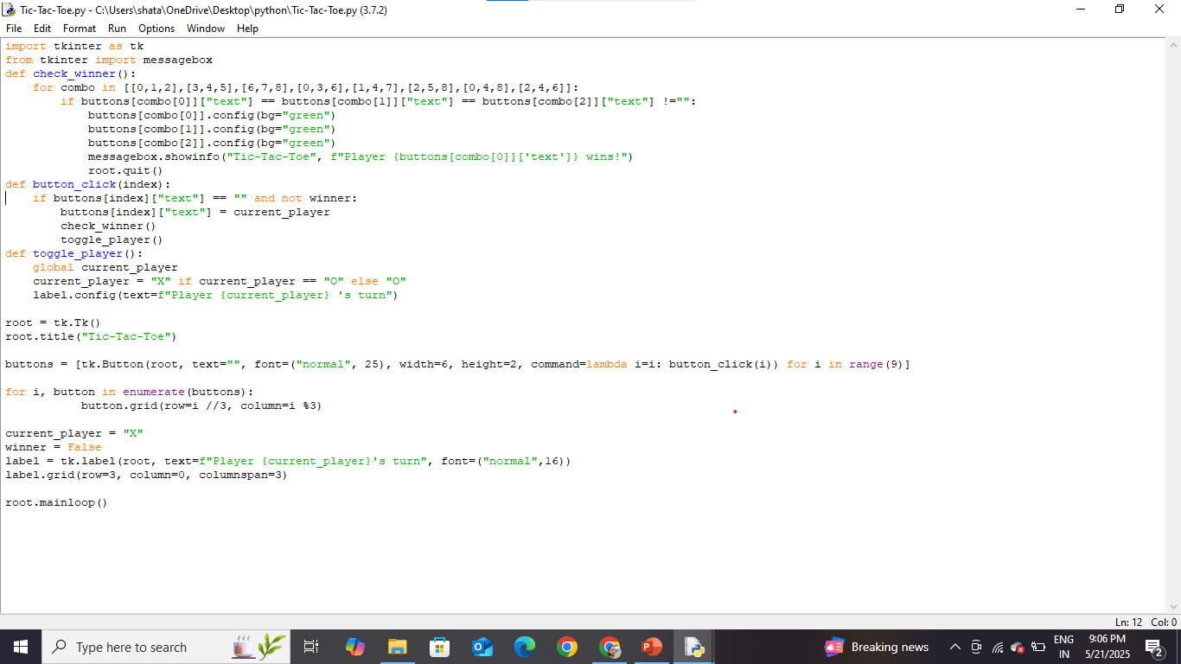

Slide 10
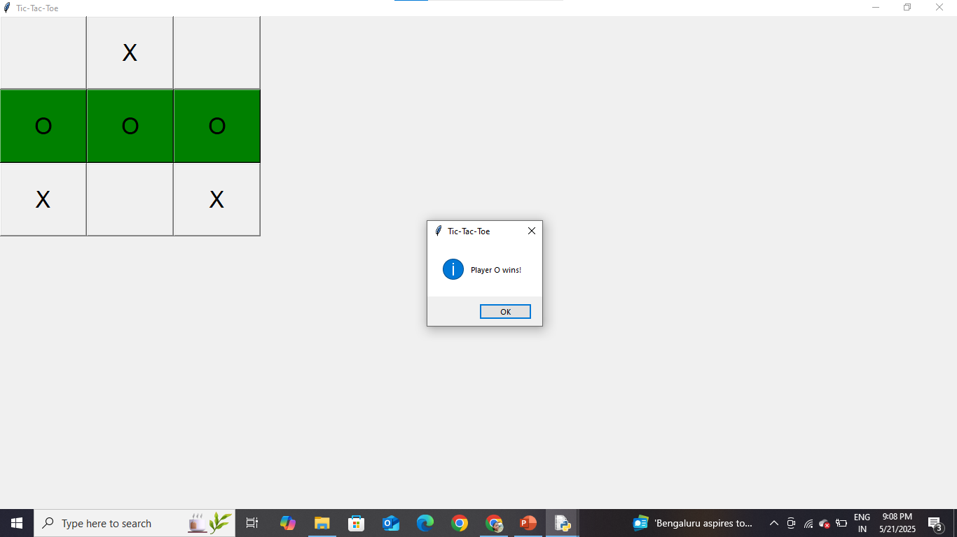
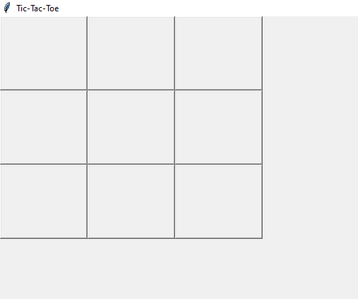
Output screens

Slide 11
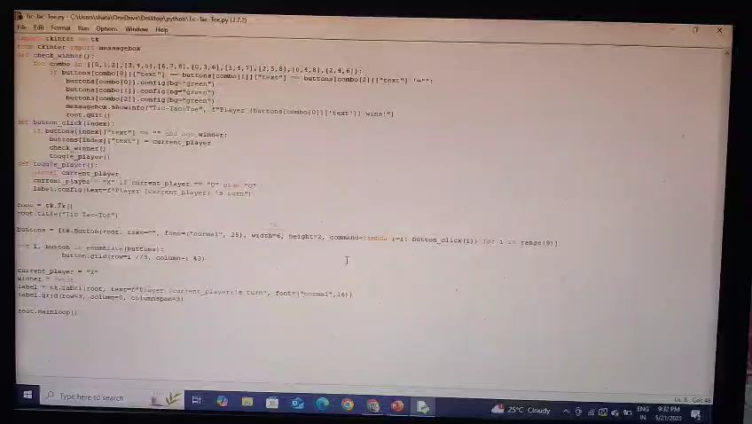

Slide 12


